Slide 1

Bird Migration Data Analysis
Presented By: Podila Deepthi
LinkedIn : https://www.linkedin.com/in/deepthi-podila/
GitHub: https://github.com/deepthi417

Slide 2
Dataset Overview
The dataset contains bird migration tracking records collected across different regions and habitats.
It includes information on flight distance, flight duration, speed, altitude, and recovery time.
Seasonal details such as migration end month are provided to study migration timing.
Environmental factors like weather condition, temperature, wind speed, and humidity are included.
Biological attributes such as species, flock size, and predator sightings are recorded.

Slide 3
Simple Description Of Some Columns In Your Dataset:
Species – Type of bird being tracked.
Region – Geographic area where migration was observed.
Habitat – Natural environment the bird passes through during migration.
Migration_End_Month – Month when the bird completes its migration.
Flight_Distance_km – Total distance travelled during migration
Flight_Duration_hours – Total time spent flying during migration (in hours).
Average_Speed_kmph – Average speed of the bird during migration.
Weather_Condition – Weather conditions during migration.
Recovery_Time_days – Number of days the bird needs to rest after migration.

Slide 4
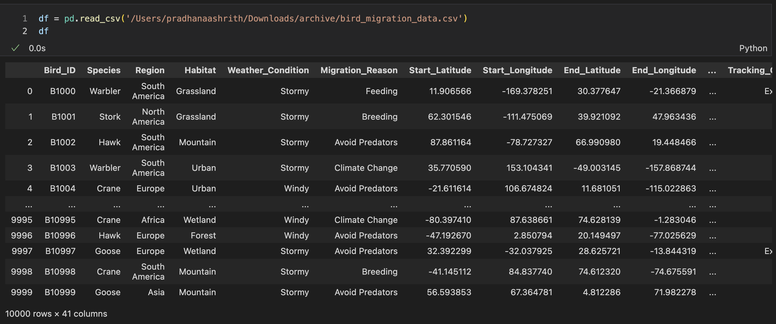
Reading Dataset

Slide 5
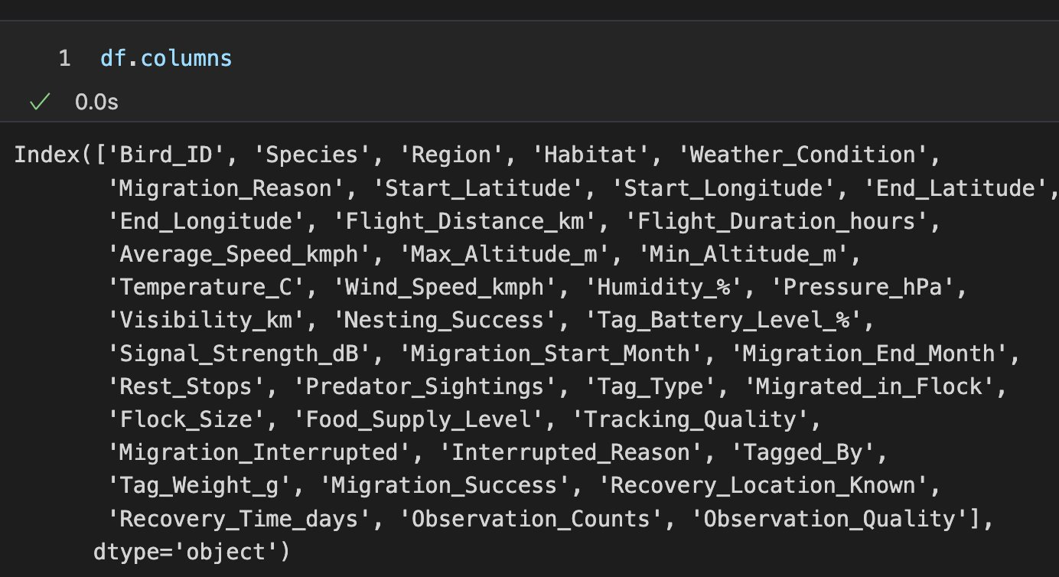
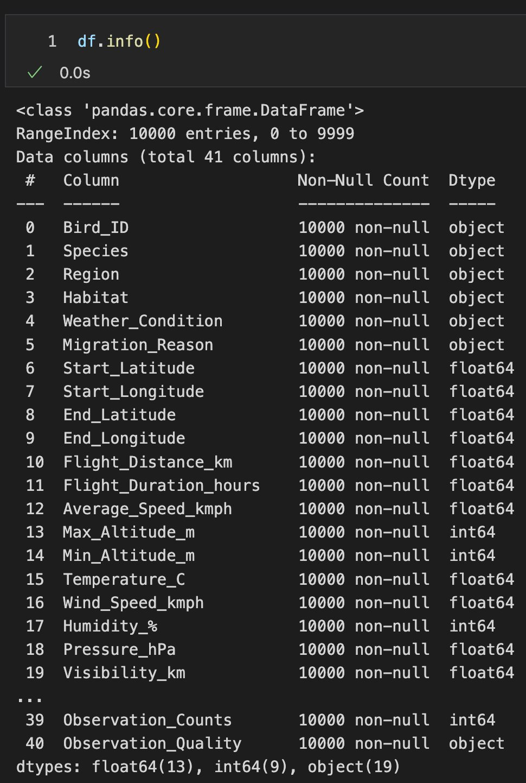
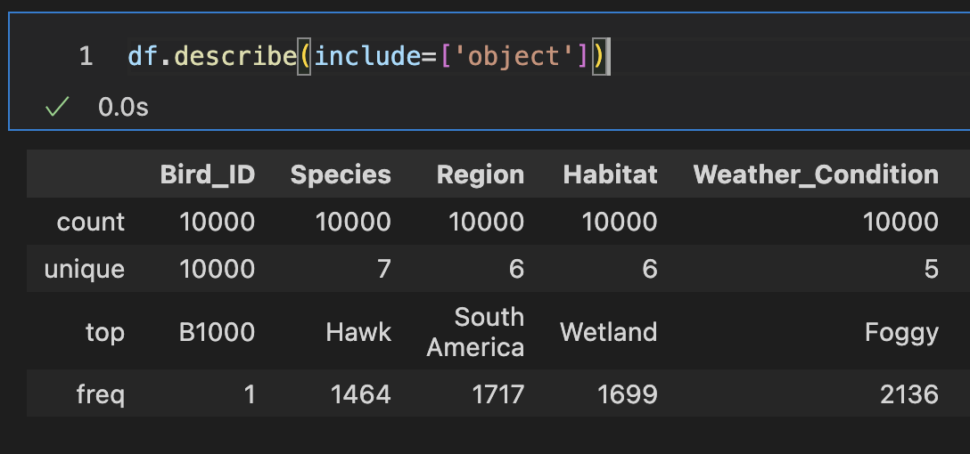
Basic Checks
Columns of the Dataset
Checking Structure of the Dataset
Checking Summary of Catagorical columns

Slide 6
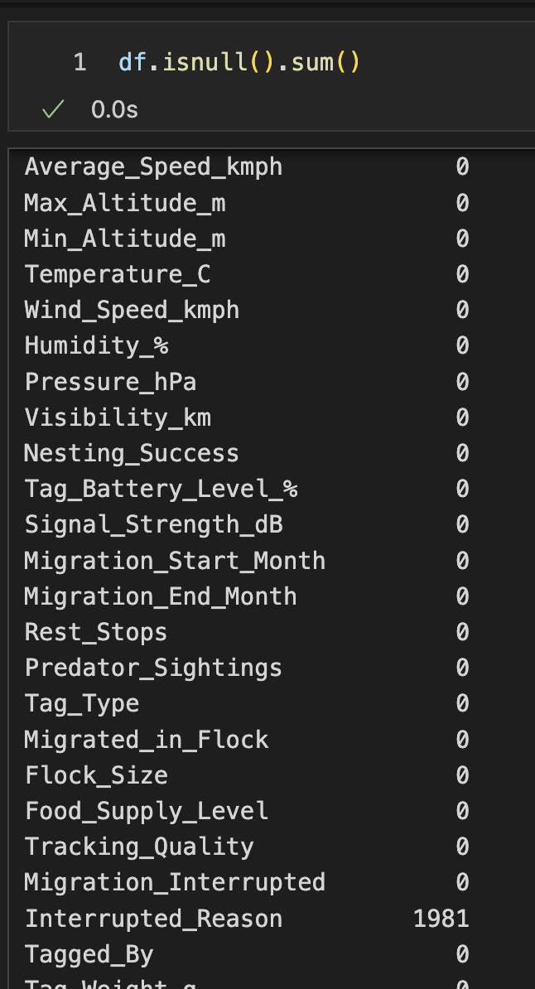
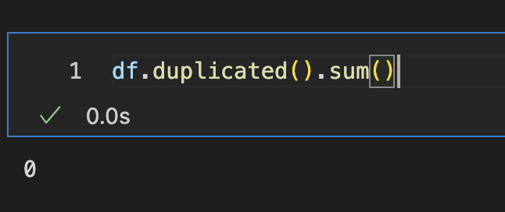
Preprocessing Techniques on Dataset Columns
Checking missing values
Checking Duplicates
Only 1 column having the missing values
No duplicates in the dataset
Now I Want to perform some Preprocessing Technique's on the only one column
Interrupted_Reason
Handling missing data of this column
Handling inconsistence Data of this column
Data Type Conversions

Slide 7
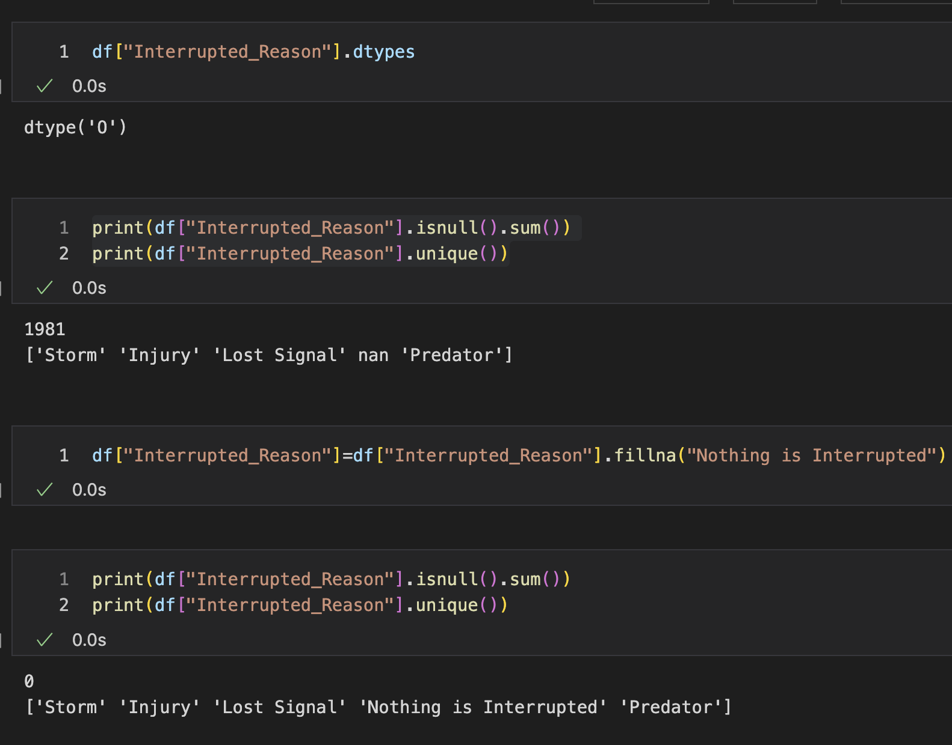
Column: Interrupted_Reason
1.Handling Missing Values
The nan is changed to Nothing is interrupted
Column : Interrupted_Reason
1.Missing values are filled with Nothing is interrupted Because the nan values are represented that noting to be noticed as interruption for some birds
2.This is the reason it is not filled with the mode for missing values
3.There is no need to fix the inconsistencies it is already in consistence order
4.I used fillna Function to fill the nan values

Slide 8
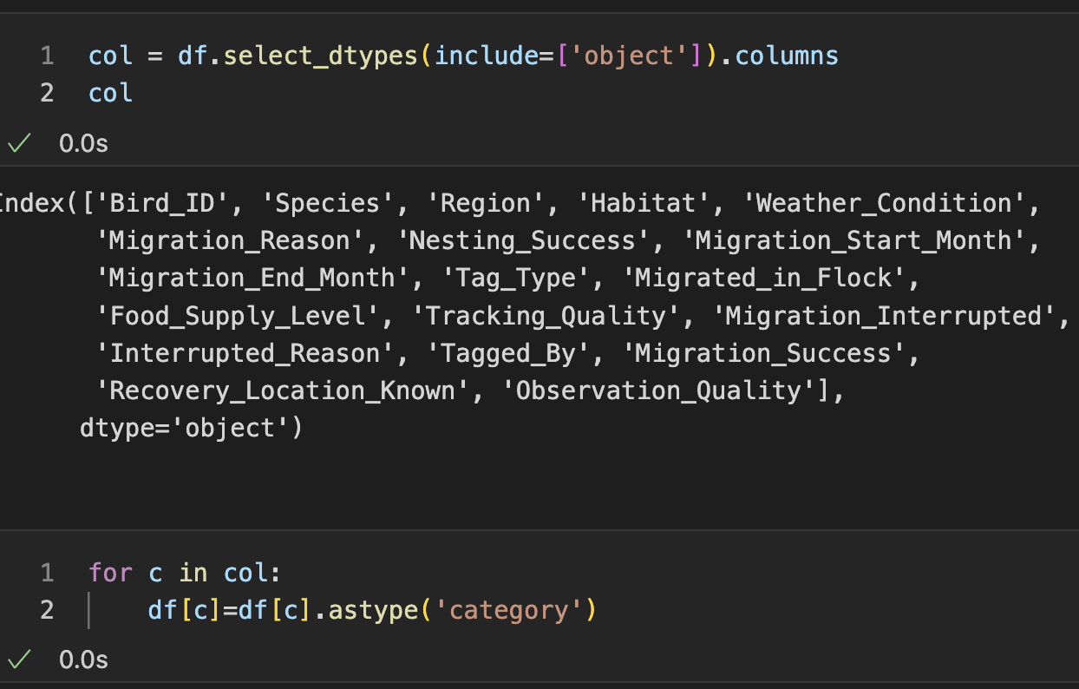
Data Type conversion
Changed the all the columns into category,float,int
Changed all these columns to the category
All the other columns are already into their dtypes
We used function as there are more number of columns present

Slide 9
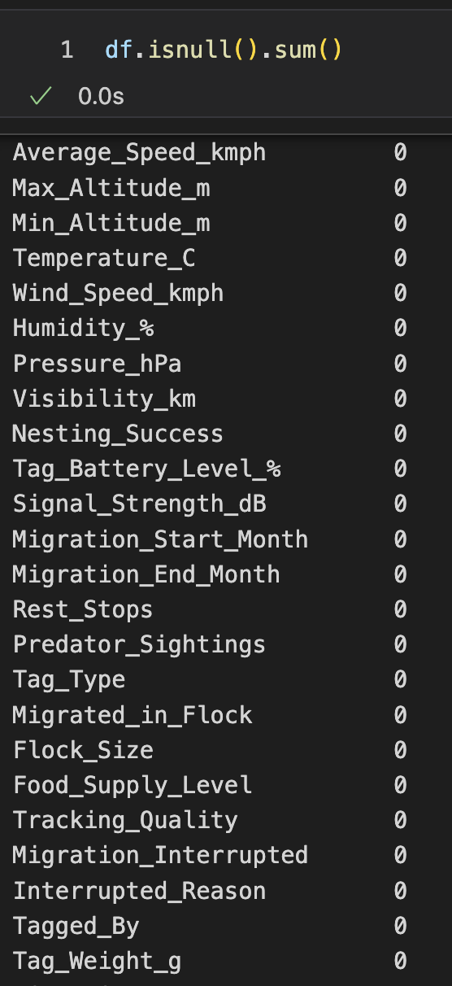
Checking Null Values After Preprocessing
All the null of the columns are become zero

Slide 10
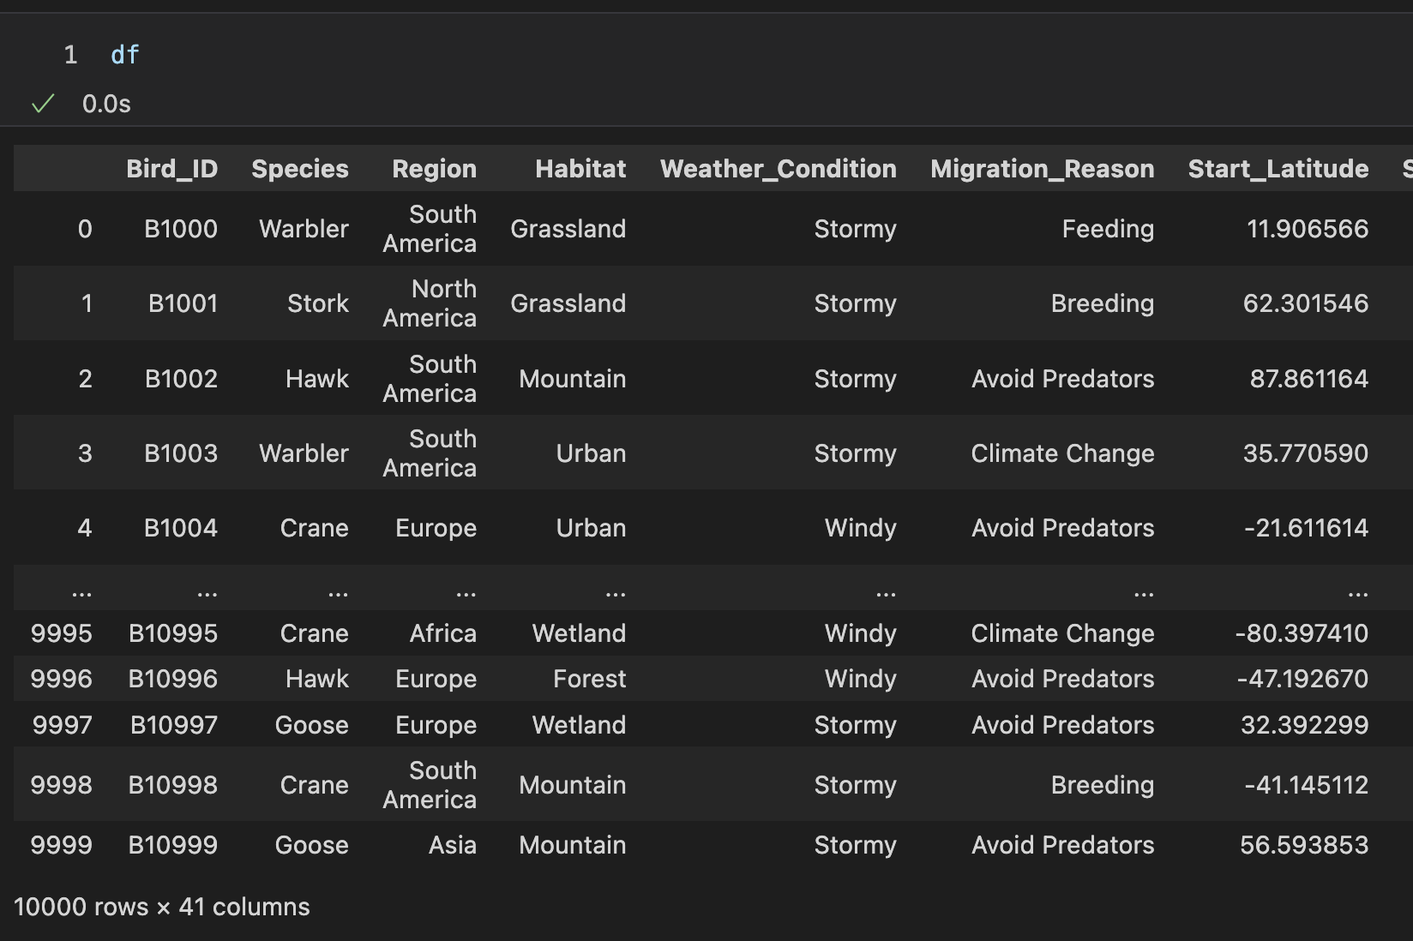
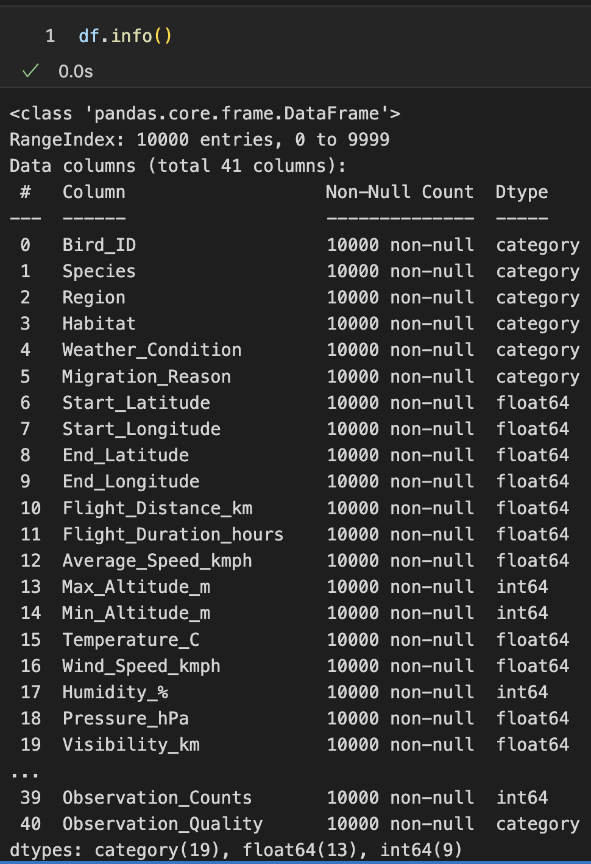
After Preprocessing of The Dataset and Cleaned
Now, The Dataset is Ready To analyse and find valuable insights.

Slide 11
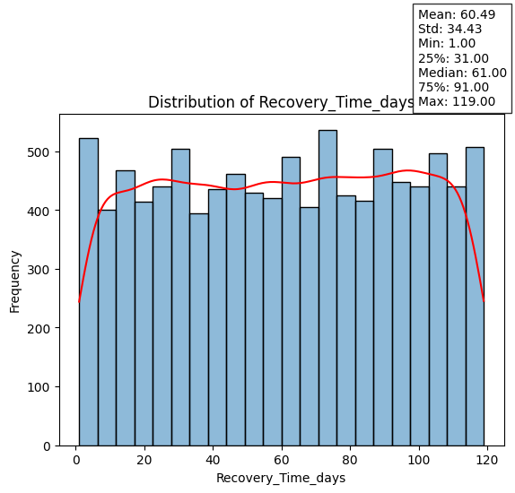
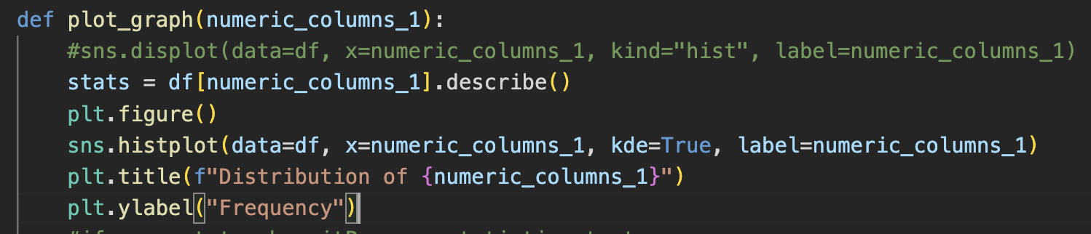
Data Analysis through Visualizations
Univariate Analysis
Distribution of Recovery_Time_days
Recovery times range dramatically (1-119 days), demonstrating the wide degree of variation.
The mean and median recovery time is around 60-61 days which suggests a relatively symmetric distribution.
The interquartile range (between which 50% of the recoveries occurred) is between the 31st - 91st days (1-3 months)

Slide 12
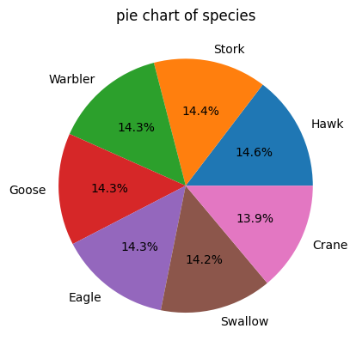
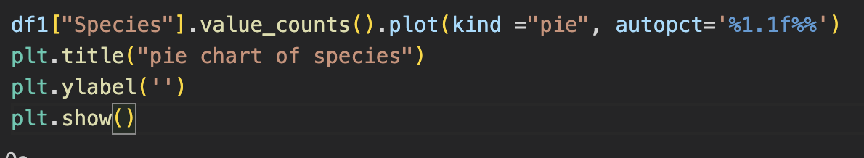
Species Distribution
Most migratory species are almost equally represented.
The proportion of species that capture data consists of approximately 14-15% of all observations of the sample.
No one particular species in the data set has a significantly greater weight than the other species.

Slide 13
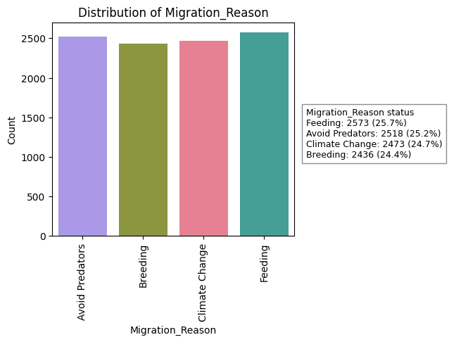
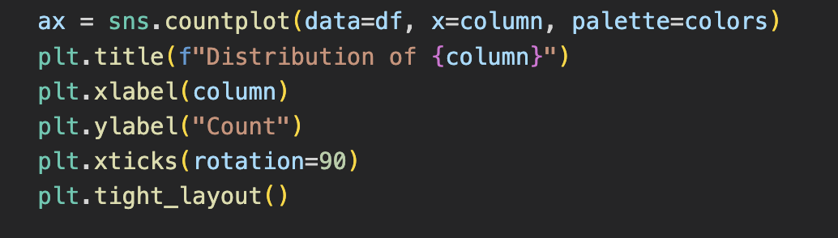
Migration Reason Distribution
Migration reasons are evenly distributed:
Feeding: ~25.7%
Avoid Predators: ~25.2%
Climate Change: ~24.7%
Breeding: ~24.4%

Slide 14
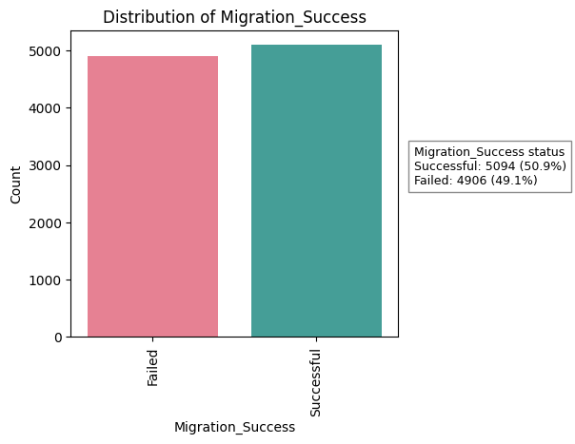
Migration Success Distribution
Successful migrations: ~50.9%
Failed migrations: ~49.1%
Success and failure rates are nearly equal.

Slide 15
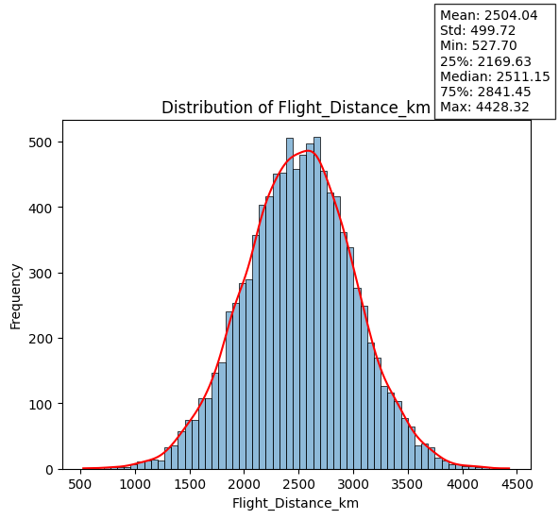
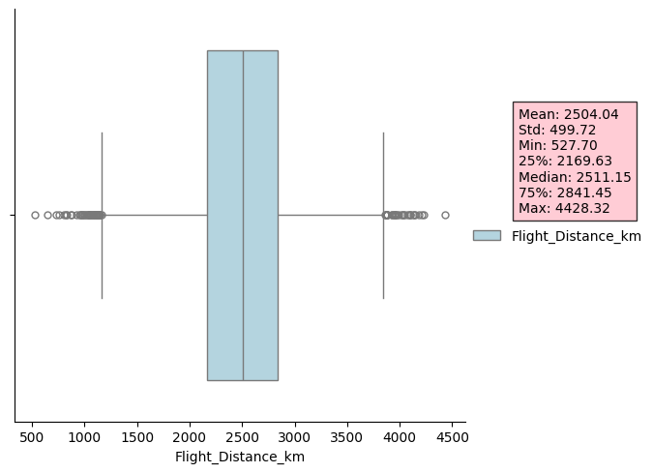
Distribution of Flight Distance
Mean Flight Distance: ~2504 km
Median Flight Distance: ~2511 km → close to the mean so it appears to be normally distributed
The majority of birds migrated between ~1700 km and ~2800 km
While there are a few long-distance outliers (many birds migrated as far as 4400 km), they are not typically representative of all migratory species that travel long distances.

Slide 16
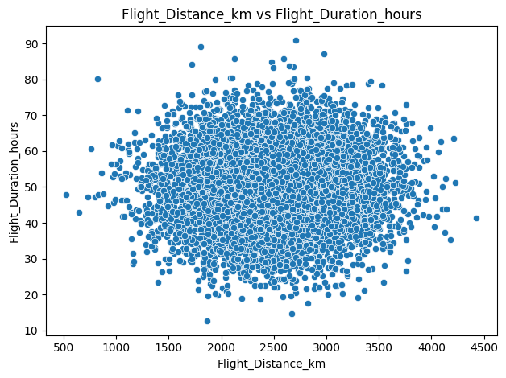
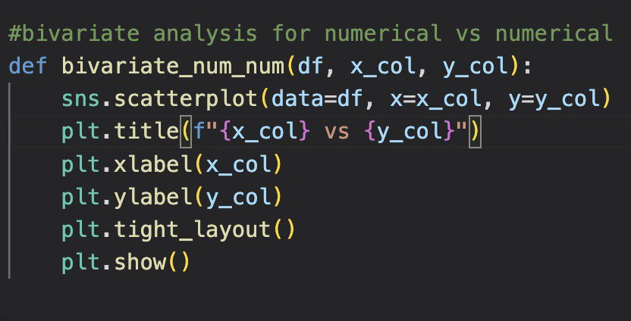
Bivariate Analysis
Flight_Distance_km vs Flight_Duration_hours
As distance travelled increases, time of flight also increases which is shown by the positive correlation between both variables (flight distance and time).
There is, however, a notable level of variance or spread among the scatter of this data indicating it is affected by a number of factors such as; weather conditions (wind patterns), length of stops, bird behaviour (different species) or the complexity of the flight paths.

Slide 17
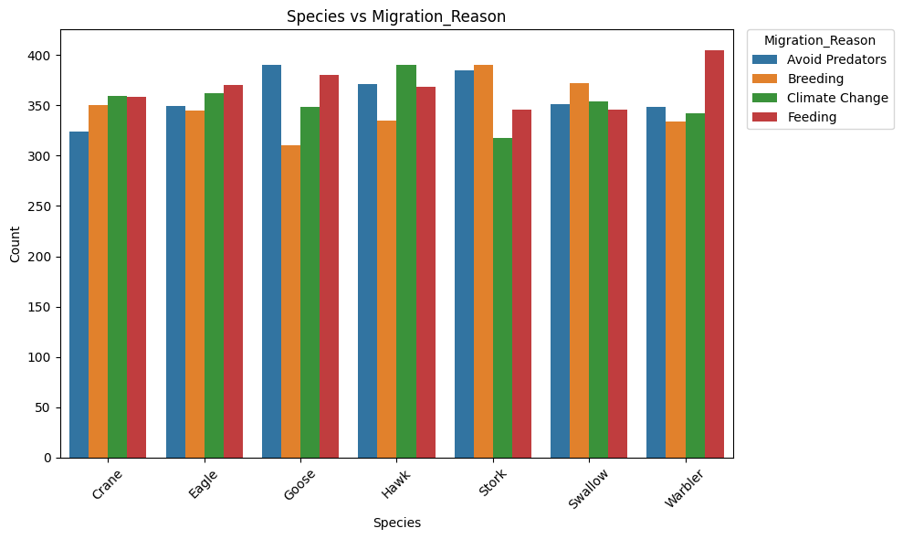
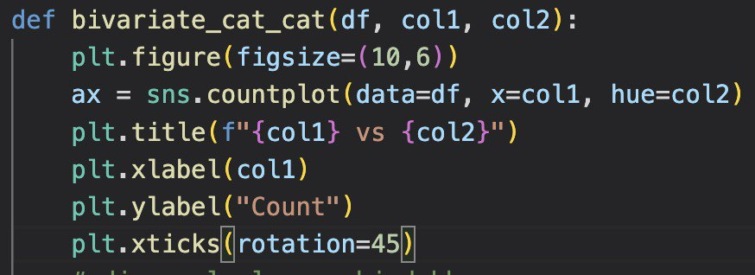
Species vs Migration_Reason
The primary reasons for migration for most animals are related to feeding and breeding.
Each type of species has its own unique reasons for migrating.
Goose & Stork: Predatory avoidance and breeding drive migration.
Hawk: Affected by climate change.
Warbler: Has the highest frequency of migration driven by feeding.
Requires a balance of reasons for migration rather than one dominant reason.

Slide 18
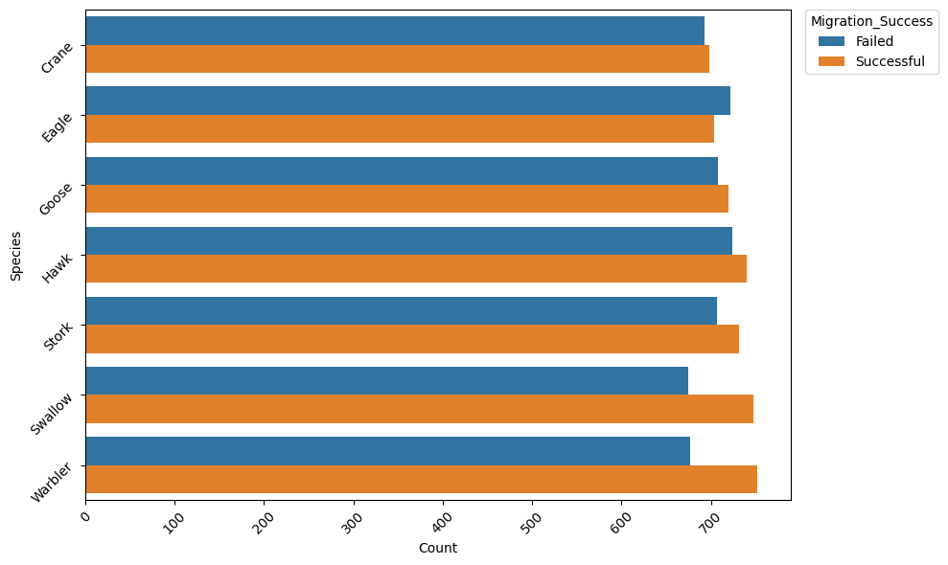
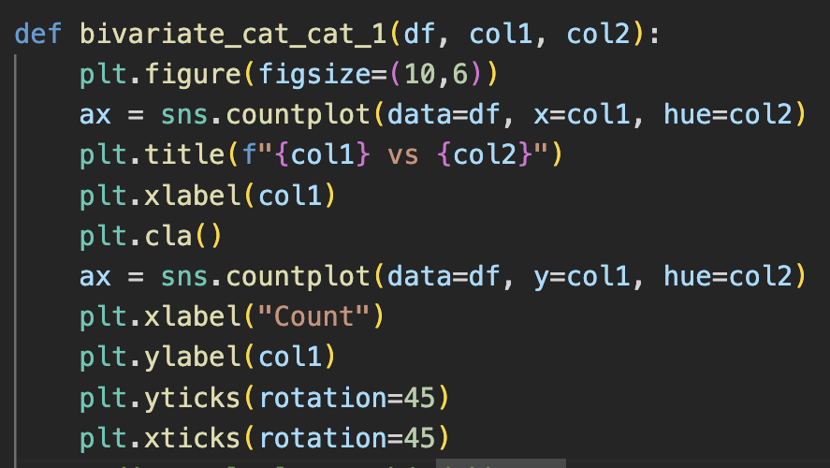
Migration Success by Species
Out of all migratory flyways, there are more failed migrations than there are successful migrations for all species combined.
The Warbler and Swallow have experienced the most successful migrations and the Crane and Eagle species have experienced proportionately higher levels of failure to success; this is due to both long distance migrations and their greater level of sensitivity to changes in the environment.

Slide 19
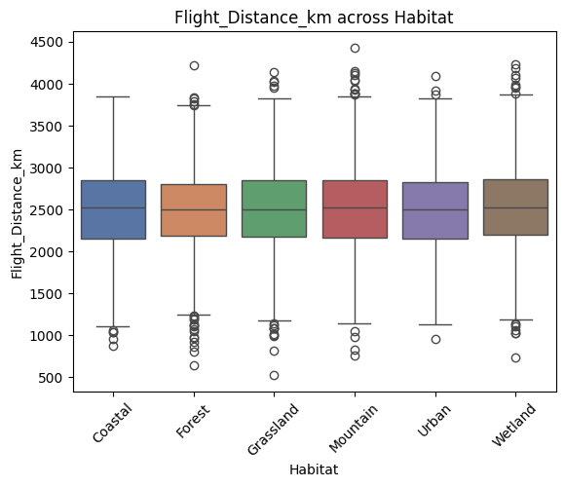
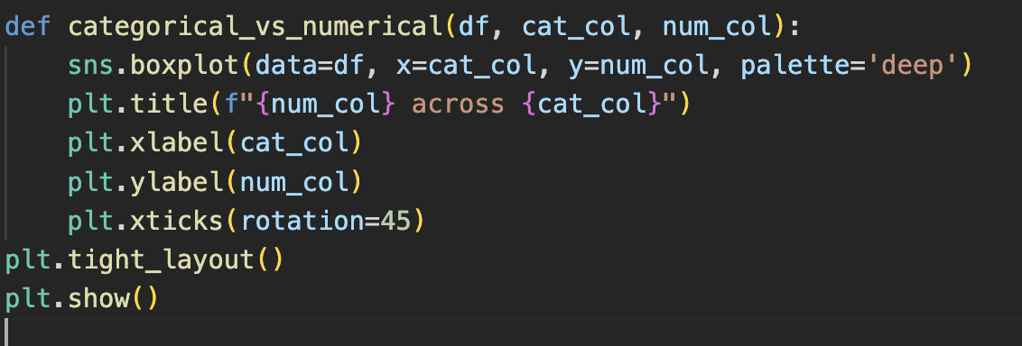
Flight_Distance_km across Habitat
Migration distance (median) is consistent (~2,400-2,600 km) across all habitats.
Examples of habitats include:
Mountain and Wetland habitats typically migrate longer distances due to the presence of higher "outlier" distances.
Forest and Grassland habitats have slightly more clustered populations based on distance migrated.

Slide 20
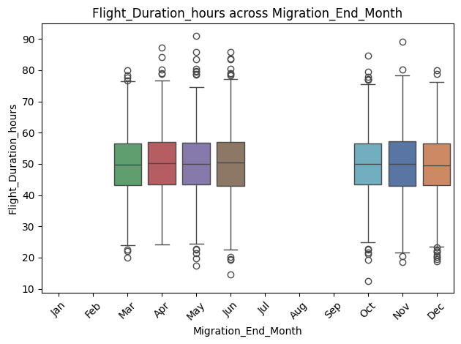
Flight_Duration_hours across Migration_End_Month
Occurrences of migration happen primarily March to June and October to December. Median Flight Duration has been stable (~45-50 hours) for most months of the year.
Between April and June; there appears to be an increase in variability in Length of Flight. April and June show the most significant Outlier ("lengthened") duration.

Slide 21
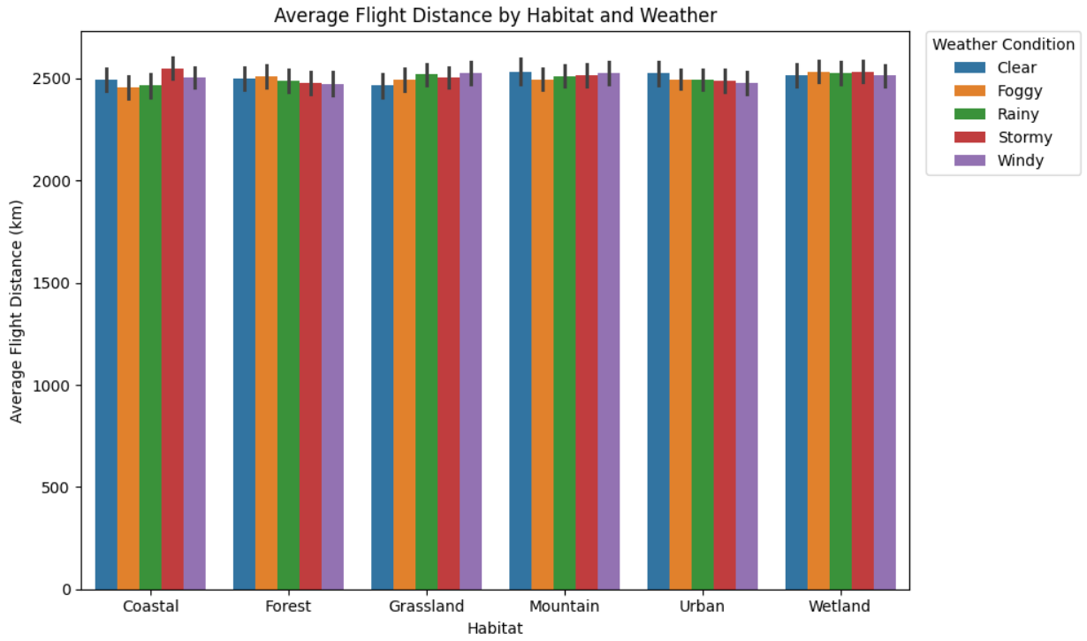
Multivariate Analysis
Average Flight Distance by Habitat & Weather
On average, birds migrate about 2450-2550 km regardless of their environment.
However, birds living in mountains and wetlands migrate slightly further than those living in other places due to longer migratory paths.
Misty weather has decreased amounts of travel due to limited visibility and difficulty navigating through the mist.

Slide 22
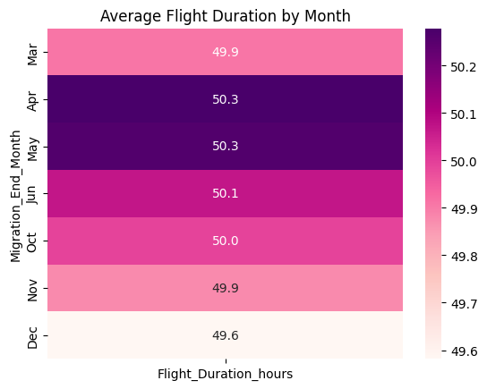
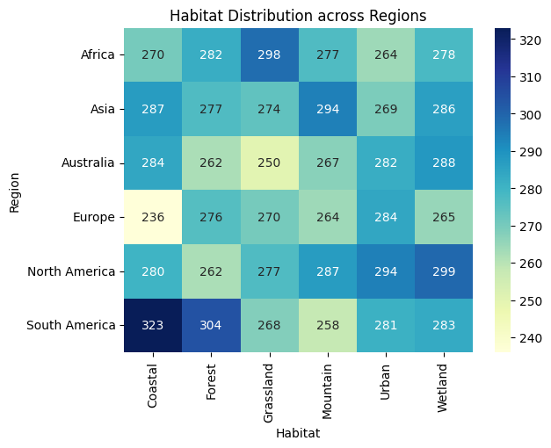
Habitat Distribution across Regions
South America has the highest number of habitat counts with a strong presence in Coastal (323) and Forest (304) Habitat types.
In contrast, North America has a good distribution of Wetland (299) and Urban (294) Habitat Types. Africa and Asia display a fairly even distribution of Habitat Types with the absence of extreme dominance of any particular type.
Europe shows a relatively lower amount of habitat counts compared to the other three continents, especially Coastal Habitat as there are only (236) Coastal Habitat counts reported
Average Flight Duration by Month
While average flight times will remain fairly consistent at between 49.6-50.3 hours each month, there are differences in the average flight time for April (50.3 hours) and May (50.3 hours), which mountain migration flights appear to have taken more time than other months.
December's average flight time is 49.6 hours, which means that flights from mountain to mountain may have been shorter or faster than those in other months.

Slide 23
Summary
Columns | Key Insights
species | Only a few bird species appear most often
habitat | Birds migrate through many habitat types
region | Migration activity is higher in certain regions
Flight_Distance_Km | Some birds travel very long distances
Migration reason | Most migrations happen for the seasonal reason
Flight_Duration_hours & migration_month | Flight duration is not same every month

Slide 24
Habitat & Flight_Distance_km | Habitat affects migration behaviour of the birds
Weather_Condition & Wind_Speed_kmph | Weather plays a major role in migration
Flight_Distance_km & Recovery_Time_Days | Longer flights needs more recovery time
Flight_Distance_km & Flight_Duration_hours | Flight distance and duration are weekly related in migration
Average_Speed_kmph | Birds speed fairly remains constant during migration
Region & Habitat | Migration patterns differ by region and habitat
Migration_End_Month | Migration changes across months
Flight_Distance_km | Some birds travel very long distance as per out layers

Slide 25

THANK YOU

